Slide 1
Particle Accelerators
Eric Prebys, FNAL
Summer Lecture Series

Slide 2
Comments
This talk will focus primarily on the evolution of the highest energy particle accelerators
This has largely driven the development of the technology; however
High energy research machines are a tiny fraction (~1%) of the particle accelerators in use today.
I’ll be fairly technical
In the end, you should have a fairly quantitative understanding of most of the accelerator jargon you’ll hear in a typical high energy physics talk:
“Lattice”
“Beta function”
“Tune”
“Emittance”
“RF”
etc…

Slide 3
Relativity and Units
Remember forever!
Basic Relativity
Units
For the most part, we will use SI units, except
Energy: eV (keV, MeV, etc) [1 eV = 1.6x10⁻¹⁹ J]
Mass: eV/c² [proton = 1.67x10⁻²⁷ kg = 938 MeV/c²]
Momentum: eV/c [proton @ β=.9 = 1.94 GeV/c]
In the US and Europe, we normally talk about the kinetic energy (K) of a particle beam, although we’ll see that momentum really makes more sense.
Some Handy Relationships
These units make these relationships really easy to calculate

Slide 4
State of the Art: Large Hadron Collider (LHC)
Built at CERN, straddling the French/Swiss border
27 km in circumference
Currently colliding beams of 6.5 TeV/beam
Design energy of 7 TeV
That’s where we are. Now let’s see how we got here…

Slide 5
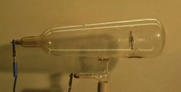
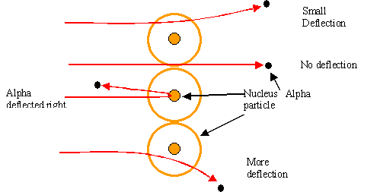
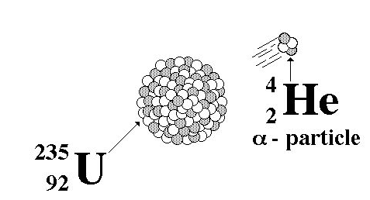
Rewind: Some Pre-History
The first artificial acceleration of particles was done using “Crookes tubes”, in the latter half of the 19th century
These were used to produce the first X-rays (1875)
At the time no one understood what was going on
The first “particle physics experiment” told Ernest Rutherford the structure of the atom (1911)
In this case, the “accelerator” was a naturally decaying ²³⁵U nucleus
Study the way radioactive particles “scatter” off of atoms

Slide 6
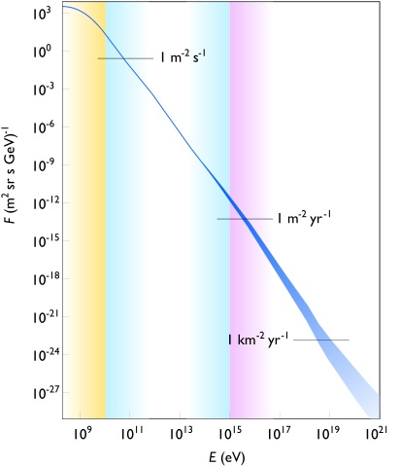
Natural Particle Acceleration
Max LHC energy
Radioactive sources produce maximum energies of a few million electron volts (MeV)
Cosmic rays reach energies of ~1,000,000,000 x LHC but the rates are too low to be useful as a study tool
Not enough “luminosity”
However, low energy cosmic rays are extremely useful for detector testing, commissioning, etc.

Slide 7
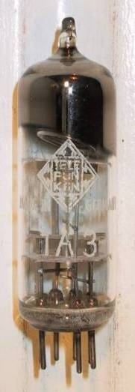
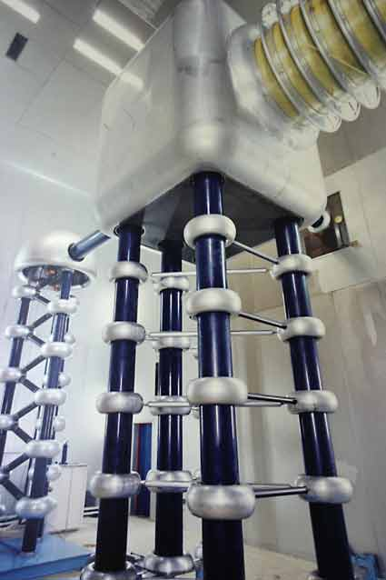
Man-made Particle Acceleration
The simplest accelerators accelerate charged particles through a static electric field. Example: vacuum tubes (or CRT TV’s)
Cathode
Anode
Limited by magnitude of electric field:
- CRT display ~keV - X-ray tube ~10’s of keV - Van de Graaf ~MeVs
Solutions:
Alternate fields to keep particles in accelerating fields -> Radio Frequency (RF) acceleration
Bend particles so they see the same accelerating field over and over -> cyclotrons, synchrotrons
Old FNAL Cockroft-Walton = 750 kV

Slide 8
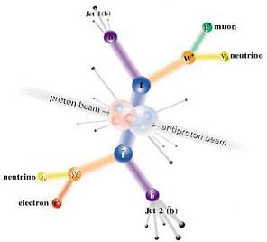
Interlude: Electrons vs. Protons
Electrons are point-like
Well-defined initial state
Full energy available to interaction
Protons are made of quarks and gluons
Interaction take place between these constituents.
Only a small fraction of energy available, not well-defined.
Rest of particle fragments -> big mess!
So why not stick to electrons?

Slide 9
Synchrotron Radiation
As the trajectory of a charged particle is deflected, it emits “synchrotron radiation”
An electron will radiate about 10¹³ times more power than a proton of the same energy!!!!
Radius of curvature
Protons: Synchrotron radiation does not affect kinematics very much
Energy limited by strength of magnetic fields and size of ring
Electrons: Synchrotron radiation dominates kinematics
To to go higher energy, we have to lower the magnetic field and go to huge rings
Eventually, we lose the benefit of a circular accelerator, because we lose all the energy each time around.
Since the beginning, the “energy frontier” has belonged to proton (and/or antiproton) machines, while electrons are used for precision studies and other purposes.
Now, back to the program…

Slide 10
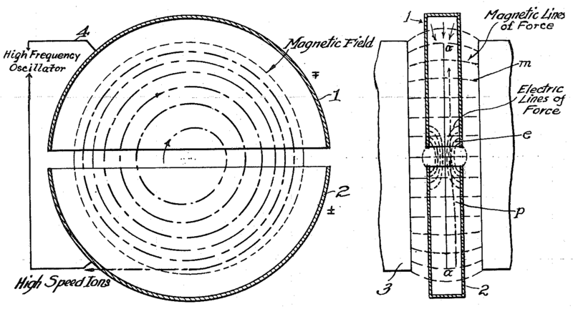
The Cyclotron (1930’s)
would not work for electrons!
side view
top view
A charged particle in a uniform magnetic field will follow a circular path of radius
“Cyclotron Frequency”
Accelerating “DEES”: by applying a voltage which oscillates at f_{c}, we can accelerator the particle a little bit each time around, allowing us to get to high energies with a relatively small voltage.
For a proton: i.e. “RF” range

Slide 11
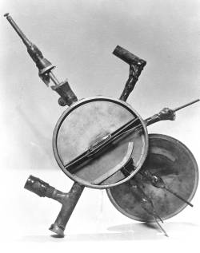
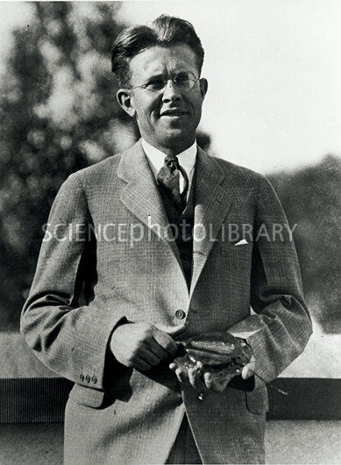
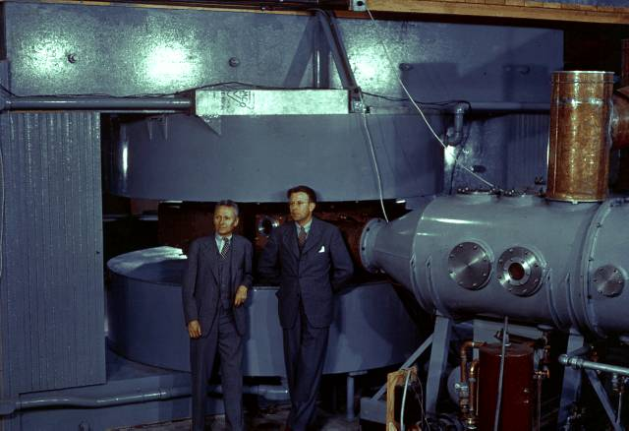
Round and Round We Go: the First Cyclotrons
~1930 (Berkeley)
Lawrence and Livingston
K=80 keV
Fit in your hand
1935 - 60” Cyclotron
Lawrence, et al. (LBL)
~19 MeV (D2)
Prototype for many

Slide 12
Onward and Upward!
Cyclotrons were limited by three problems
Constant frequency breaks down at ~10% speed of light
Solved with variable frequency “synchro-cyclotrons” ➔ phase stability (more about this later)
As energy goes up, magnet gets huge
Beams are not well focused and get larger with energy
Two major advances allowed accelerators to go beyond the energies and intensities possible at cyclotrons
“Synchrotron” – in which the magnetic field is increased as the energy increases (proportional to momentum), such that particles continue to follow the same path .
“Strong focusing” – a technique in which magnetic gradients (non-uniform fields) are used to focus particles and keep them in a smaller beam pipe than was possible with cyclotrons.
Note: still plenty of uses for cyclotrons (simple, inexpensive, rapid cycling)
Medical treatments
Isotope production
Nuclear physics

Slide 13
Understanding Beam Motion: Beam “rigidity”
The relativistically correct form of Newton’s Laws for a particle in an electromagnetic field is:
A particle of unit charge in a uniform magnetic field will move in a circle of radius
side view
top view
constant for fixed energy!
T-m²/s=V
units of eV in our usual convention
Beam “rigidity” = constant at a given momentum (even when B=0!)
Remember forever!
If all magnetic fields are scaled with the momentum as particles accelerate, the trajectories remain the same
➔“synchrotron” [E. McMillan, 1945]

Slide 14
Example Beam Parameters
Compare Fermilab LINAC (K=400 MeV) to LHC (K=7000 GeV)
Parameter | Symbol | Equation | Injection | Extraction
proton mass | m [GeV/c²] |  | 0.938
kinetic energy | K [GeV] |  | .4 | 7000
total energy | E [GeV] |  | 1.3382 | 7000.938
momentum | p [GeV/c] |  | 0.95426 | 7000.938
rel. beta | β |  | 0.713 | 0.999999991
rel. gamma | γ |  | 1.426 | 7461.5
beta-gamma | βγ |  | 1.017 | 7461.5
rigidity | (Bρ) [T-m] |  | 3.18 | 23353.
This would be the radius of curvature in a 1 T magnetic field or the field in Tesla needed to give a 1 m radius of curvature.

Slide 15
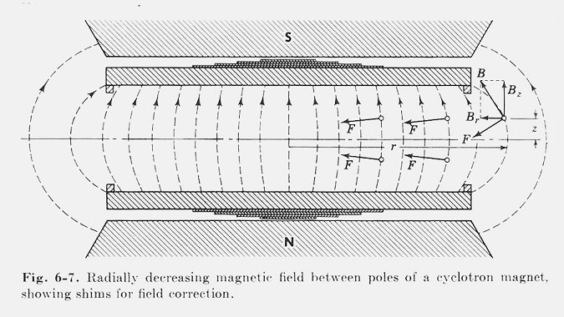
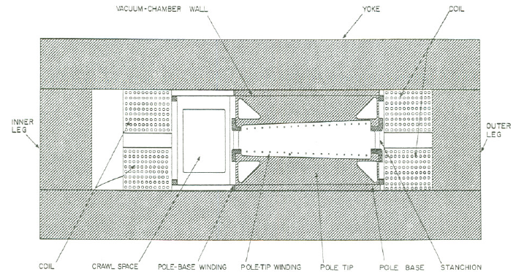
Weak Focusing
Cyclotrons relied on the fact that magnetic fields between two pole faces are never perfectly uniform.
This prevents the particles from spiraling out of the pole gap.
In early synchrotrons, radial field profiles were optimized to take advantage of this effect, but in any weak focused beams, the beam size grows with energy.
The highest energy weak focusing accelerator was the Berkeley Bevatron, which had a kinetic energy of 6.2 GeV
High enough to make antiprotons (and win a Nobel Prize)
It had an aperture 12”x48”!

Slide 16
Strong Focusing
Strong focusing utilizes alternating magnetic gradients to precisely control the focusing of a beam of particles
The principle was first developed in 1949 by Nicholas Christofilos, a Greek-American engineer, who was working for an elevator company in Athens at the time.
Rather than publish the idea, he applied for a patent, and it went largely ignored.
The idea was independently invented in 1952 by Courant, Livingston and Snyder, who later acknowledged the priority of Christophilos’ work.
Courant and Snyder wrote a follow-up paper in 1958, which contains the vast majority of the accelerator physics concepts and formalism in use to this day!
Although the technique was originally formulated in terms of magnetic gradients, it’s much easier to understand in terms of the separate functions of dipole and quadrupole magnets.

Slide 17
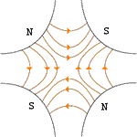
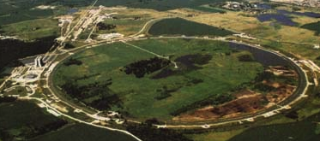

Combined Function vs. Separated Function
Strong focusing was originally implemented by building magnets with non-parallel pole faces to introduce a linear magnetic gradient
=
+
dipole
quadrupole
CERN PS (1959, 29 GeV)
Later synchrotrons were built with physically separate dipole and quadrupole magnets. The first “separated function” synchrotron was the Fermilab Main Ring (1972, 400 GeV)
+
=
dipole
quadrupole
Fermilab
Strong focusing is also much easier to teach using separated functions, so we will…

Slide 18
Thin Lens Approximation and Magnetic “kick”
If the path length through a transverse magnetic field is short compared to the bend radius of the particle, then we can think of the particle receiving a transverse “kick”, which is proportional to the integrated field
and it will be bent through small angle
In this “thin lens approximation”, a dipole is the equivalent of a prism in classical optics.

Slide 19
Quadrupole Magnets* as Lenses
A positive particle coming out of the page off center in the horizontal plane will experience a restoring kick proportional to the displacement
just like a “thin lens” with focal length
*or quadrupole term in a gradient magnet

Slide 20
What About the Other Plane?
Defocusing!
Luckily, if we place equal and opposite pairs of lenses, there will be a net focusing regardless of the order.
➔pairs give net focusing in both planes -> “FODO cell”

Slide 21
Formalism: Coordinates and Conventions
We generally work in a right-handed coordinate system with x horizontal, y vertical, and s along the nominal trajectory (x=y=0).
Note: s (rather than t) is the independent variable
Particle trajectory defined at any point in s by location in x,x’ or y,y’ “phase space”
unique initial phase space point ➔ unique trajectory

Slide 22
Transfer Matrices
Dipoles define the trajectory, so the simplest magnetic “lattice” consists of quadrupoles and the spaces in between them (drifts). We can express each of these as a linear operation in phase space.
By combining these elements, we can represent an arbitrarily complex ring or line as the product of matrices.
Quadrupole:
Drift:

Slide 23
Example: Transfer Matrix of a FODO cell
At the heart of every beam line or ring is the basic “FODO” cell, consisting of a focusing and a defocusing element, separated by drifts:
Can build this up to describe any beam line or ring
f
-f
L
L
Remember: motion is usually drawn from left to right, but matrices act from right to left!
Sign of f flips in other plane

Slide 24
Periodic Systems
You might think, “Start with a beam line, then make a ring out of it.”
Difficult to solve general case, because it depends on the initial conditions
Therefore, we initially solve for stable motion in a periodic system
We can think of a ring made of identical FODO cells as just the same cell, over and over.
Periodic “cell”
FODO Cell
Our goal is to decouple the problem into two parts
The “lattice”: a mathematical description of the machine itself, based only on the magnetic fields, which is identical for each identical cell
The “emittance”: mathematical description for the ensemble of particles circulating in the machine.
Extend to beam lines by using boundary conditions (“matching”)

Slide 25
General Solution: Betatron Motion
We find (after a lot of algebra) that we can describe particle motion in terms of initial conditions and a “beta function” β(s), which is only a function of location along the nominal path, and follows the periodicity of the machine.
In other words, particles undergo “pseudo-harmonic” motion about the nominal trajectory, with a variable wavelength.
Note: β has units of [length], so the amplitude has units of [length]^{1/2}
x
Lateral deviation in one plane
s
The “betatron function” β(s) is effectively the local wavenumber and also defines the beam envelope.
Phase advance

Slide 26
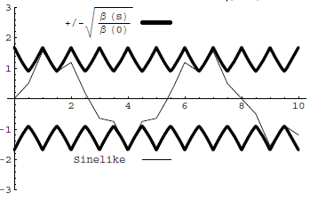
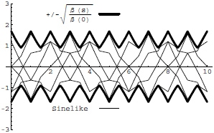
Conceptual Understanding of β
It’s important to remember that the betatron function represents a bounding envelope to the beam motion, not the beam motion itself
Normalized particle trajectory
Trajectories over multiple turns (or trajectories of multiple particles!)
β(s) is also effectively the local wave number which determines the rate of phase advance
Closely spaced strong quads ➔ small β ➔ small aperture, lots of wiggles
Sparsely spaced weak quads ➔ large β ➔ large aperture, few wiggles

Slide 27
Characterizing Particle Ensembles: Emittance
A particle returning to the same point over many terms traces an ellipse, defined by the “beta function”, β, and two additional lattice parameters, α and γ.
An ensemble of particles can characterized by a bounding ellipse, known as the “emittance”
Definitions vary: RMS, 95%, 99%, etc
NOT to be confused with relativistic β and γ!
Units of length
Area = επ

Slide 28
Emittance, Beam Size, and Adiabatic Damping
If we use the Guassian definition emittance, then the beam size is
Emittance is constant at a constant energy, but as particles accelerate, the emittance decreases
This is known as “adiabatic damping”. We therefore define a “normalized emittance”
which is constant with energy. Thus, at a particular energy
Relativistic β and γ (yes, I know it’s confusing)

Slide 29
Emittance and Beam Distributions
As we go through a lattice the shape in phase space varies, by the bounding emittance remains constant
β = max α = 0
➔maximum
β = decreasing α >0
➔focusing
β = min α = 0
➔minimum
β = increasing α < 0
➔defocusing
large spatial distribution
small angular distribution
small spatial distribution
large angular distribution

Slide 30
Betatron Tune
Particle trajectory
As particles go around a ring, they will undergo a number of betatrons oscillations ν (sometimes Q) given by
This is referred to as the “tune”
Ideal orbit
We can generally think of the tune in two parts:
6.7
Integer : magnet/aperture optimization
Fraction: Beam Stability

Slide 31
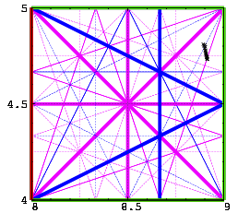
Tune, Stability, and the Tune Plane
If the tune is an integer, or low order rational number, then the effect of any imperfection or perturbation will tend be reinforced on subsequent orbits.
When we add the effects of coupling between the planes, we find this is also true for combinations of the tunes from both planes, so in general, we want to avoid
Many instabilities occur when something perturbs the tune of the beam, or part of the beam, until it falls onto a resonance, thus you will often hear effects characterized by the “tune shift” they produce.
For example: the maximum tune shift sets the absolute luminosity limit in a collider
“small” integers
➔Avoid lines in the “tune plane”

Slide 32
Longitudinal Motion
We will generally accelerate particles using structures that generate time-varying electric fields (RF cavities), either in a linear arrangement
or located within a circulating ring
In both cases, we want to phase the RF so a nominal arriving particle will see the same accelerating voltage and therefore get the same boost in energy
cavity 0
cavity 1
cavity N
Nominal Energy

Slide 33
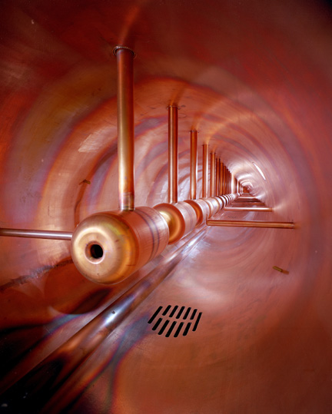
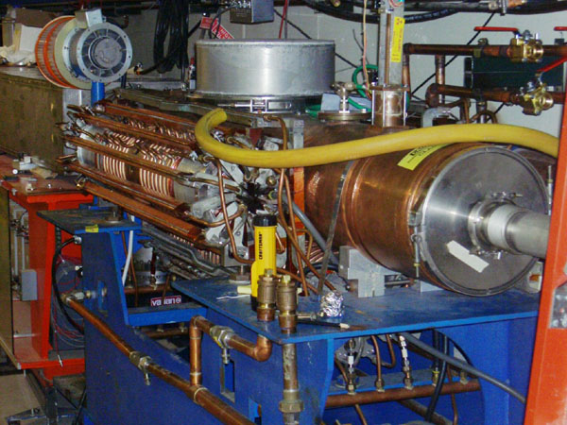
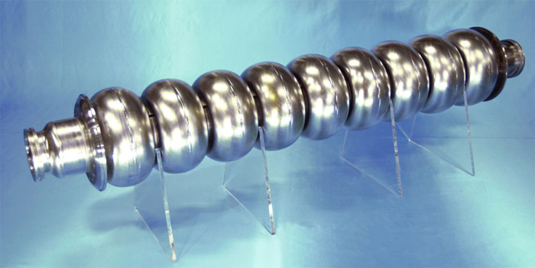
Examples of Accelerating RF Structures
37->53MHz Fermilab Booster cavity
Biased ferrite frequency tuner
Fermilab Drift Tube Linac (200MHz): oscillating field uniform along length
ILC prototype elipical cell “π-cavity” (1.3 GHz): field alternates with each cell

Slide 34
Phase Stability
A particle with a slightly different energy will arrive at a slightly different time, and experience a slightly different acceleration
Longitudinal motion about stable phase referred to as “synchrotron motion”.
Takes many revolutions to complete one longitudinal cycle in a synchrotron, so multiple RF cavities are just seen as a vector sum.
Off Energy
Nominal Energy
“slip factor” = dependence of period on momentum
- negative for linacs
- positive for (relativistic)
cyclotrons
- goes from negative to
positive in synchrotrons (“transition”)
Stable point depends on sign.

Slide 35
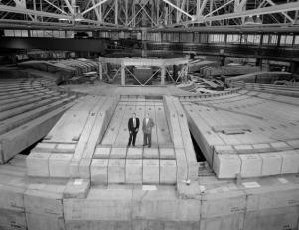
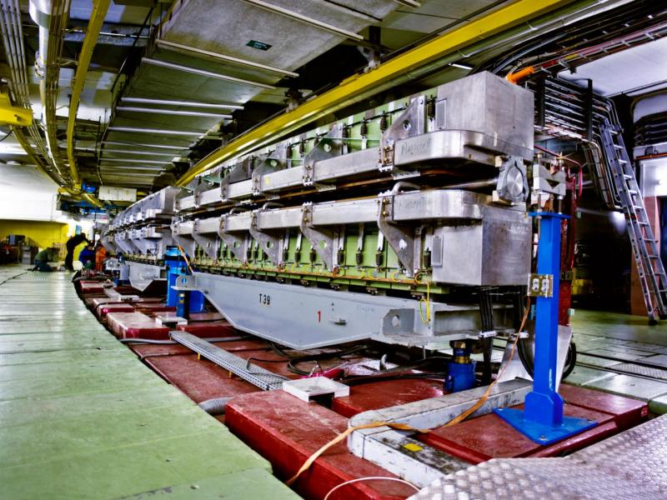
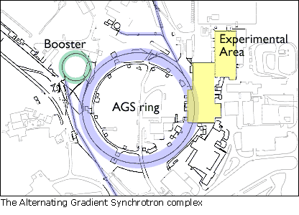
Some Important Early Synchrotrons
Berkeley Bevatron,
1954 (weak focusing)
6.2 GeV protons
Discovered antiproton
CERN Proton Synchrotron (PS)
1959
628 m circumference
28 GeV protons
Still used in LHC injector chain!
Brookhaven Alternating Gradient Synchrotron (AGS)
1960
808 m circumference
33 GeV protons
Discovered charm quark, CP violation, muon neutrino

Slide 36
Getting the Most Energy: The Case for Colliders
If beam hits a stationary proton, the “center of mass” energy is
On the other hand, for colliding beams (of equal mass and energy) it’s
To get the 14 TeV CM design energy of the LHC with a single beam on a fixed target would require that beam to have an energy of 100,000 TeV!
Would require a ring 10 times the diameter of the Earth!!
Getting to the highest energies requires colliding beams

Slide 37
Luminosity
Rate
The relationship of the beam to the rate of observed physics processes is given by the “Luminosity”
Cross-section (“physics”)
“Luminosity”
Standard unit for Luminosity is cm⁻²s⁻¹ Standard unit of cross section is “barn”=10⁻²⁴ cm² Integrated luminosity is usually in barn⁻¹,where
nb⁻¹ = 10⁹ b⁻¹, fb⁻¹=10¹⁵ b⁻¹, etc
For (thin) fixed target:
Target thickness
Example: MiniBooNe primary target:
Incident rate
Target number density

Slide 38
Luminosity of Colliding Beams
Particles in a bunch
For equally intense Gaussian beams
Using we have
Collision frequency
Geometrical factor: - crossing angle - hourglass effect
Transverse size (RMS)
prop. to energy
Normalized emittance
Revolution frequency
Betatron function at collision point ➔ want a small β*!
Number of bunches
Particles in bunch
Record e+e- Luminosity (KEK-B): 2.11x10³⁴ cm⁻²s⁻¹ Record p-pBar Luminosity (Tevatron): 4.06x10³² cm⁻²s⁻¹ Record Hadronic Luminosity (LHC): 7.0x10³³ cm⁻²s⁻¹ LHC Design Luminosity: 1.00x10³⁴ cm⁻²s⁻¹

Slide 39
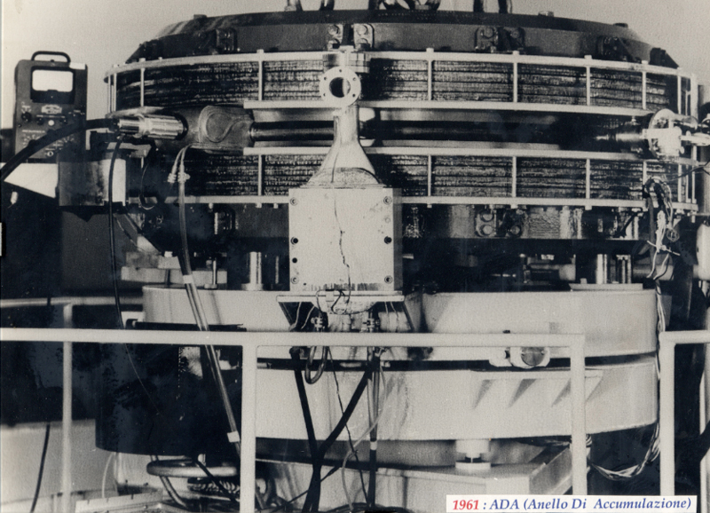
First e⁺e⁻ Collider
ADA (Anello Di Accumulazione) at INFN, Frascati, Italy (1961)
250 MeV e⁺ x 250 MeV e⁻
It’s easier to collide e+e-, because synchrotron radiation naturally “cools” the beam to smaller size.

Slide 40
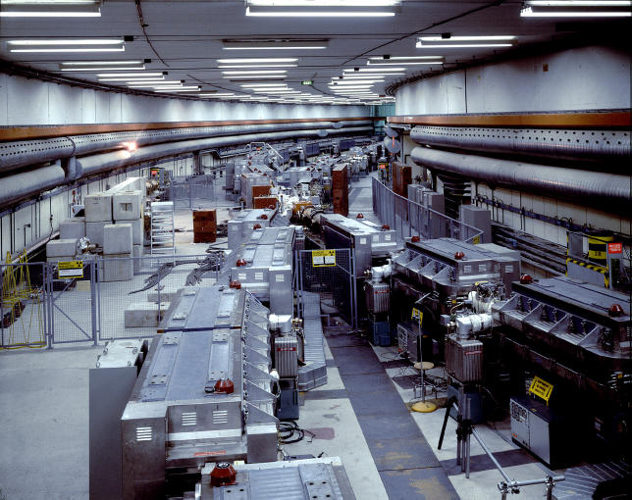
First Proton Collider: CERN Intersecting Storage Rings (ISR)
1971
31 GeV + 31 GeV colliding proton beams.
Highest CM Energy for 10 years
Set a luminosity record that was not broken for 28 years!

Slide 41
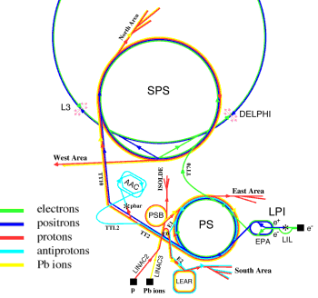
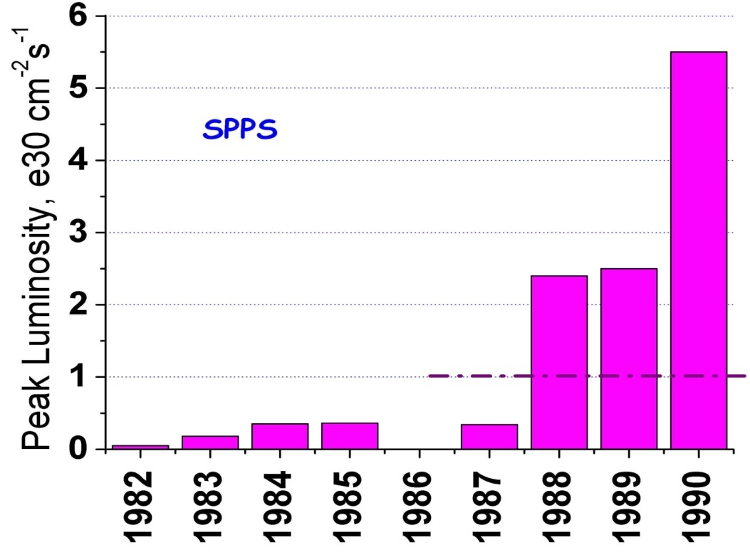
SppS: First Proton-Antiproton Collider
Protons from the SPS were used to produce antiprotons, which were collected
These were injected in the opposite direction (same beam pipe) and accelerated
First collisions in 1981
Discovery of W and Z in 1983
Nobel Prize for Rubbia and Van der Meer
Energy initially 270+270 GeV
Raised to 315+315 GeV
Limited by power loss in magnets!
design

Slide 42
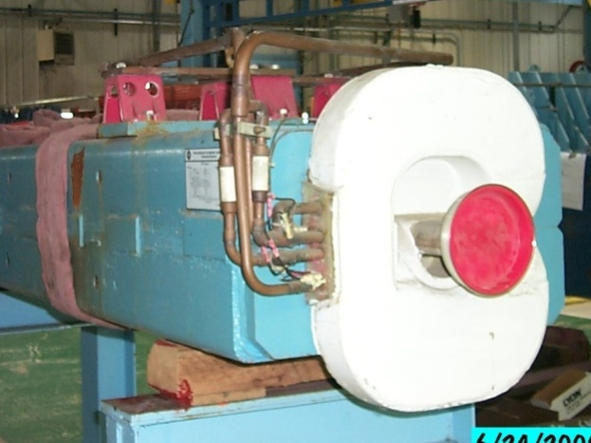
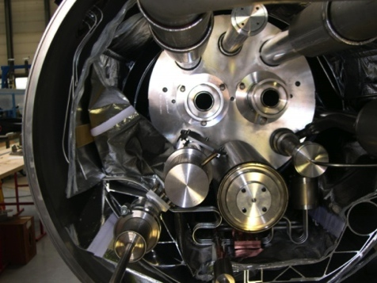
Superconductivity: Enabling Technology
The maximum SppS energy was limited by the maximum power loss that the conventional magnets could support.
LHC made out of such magnets would be roughly the size of Rhode Island!
Highest energy colliders only possible using superconducting magnets
Must take the bad with the good
Conventional magnets are Superconducting magnets are simple and naturally dissipate complex and represent a great energy as they operate deal of stored energy which must be handled if something goes wrong
R&D into superconducting technology is absolutely critical in the quest for the highest energies (made Tevatron and LHC possible!)
Machine protection is one of the biggest challenges.

Slide 43
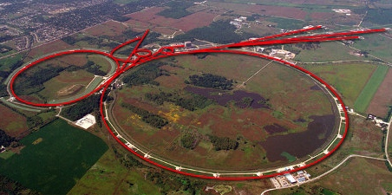
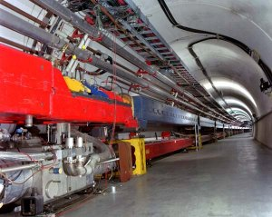
Tevatron: First Superconducting Synchrotron
1968 – Fermilab Construction Begins
1972 – Beam in Main Ring
(normal magnets)
Plans soon began for a superconducting collider to share the ring.
Dubbed “Saver Doubler” (later “Tevatron”)
1985 – First proton-antiproton collisions in Tevatron
Most powerful accelerator in the world for the next quarter century
1995 – Top quark discovery
2011 – Tevatron shut down after successful LHC startup
Main Ring
Tevatron

Slide 44
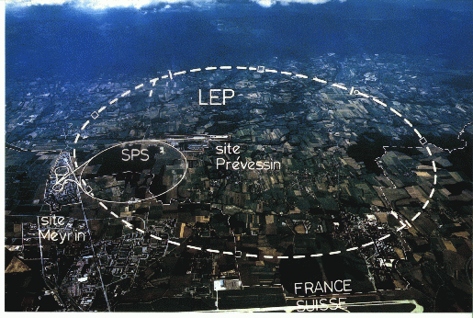
Back the present: Large Hadron Collider
My House (1990-1992)
/LHC
Straddles French/Swiss border near Geneva, Switzerland
Tunnel originally dug for LEP
Built in 1980’s as an electron positron collider
Max 100 GeV/beam, but 27 km in circumference!!

Slide 45
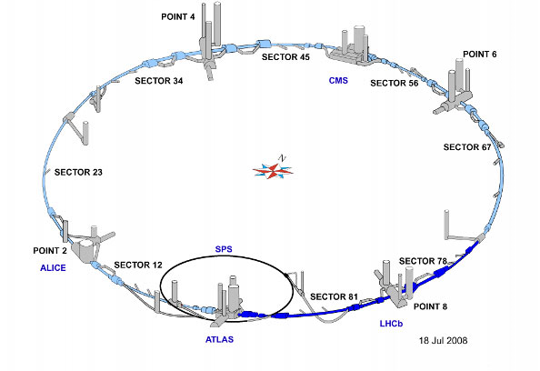
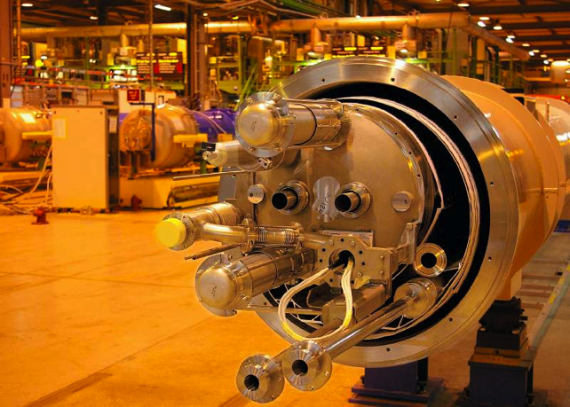
LHC Layout and Numbers
Design:
7 TeV+7 TeV proton beams
7 times Fermilab Tevatron
Magnets have two beam pipes, one going in each direction.
Stored beam energy 150 times more than Tevatron
Each beam has only 5x10⁻¹⁰ grams of protons, but has the energy of a train going 100 mph!!
These beams are focused to a size smaller than a human hair to collide with each other!
27 km in circumference
2 major collision regions: CMS and ATLAS
2 “smaller” regions: ALICE and LHCb

Slide 46
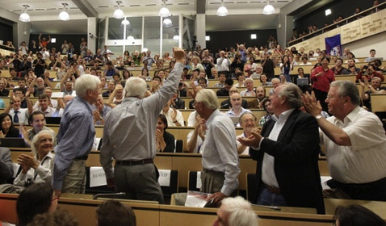
Partial LHC Timeline
2008
September 10th: First circulating beam
September 19th: BAD accident brings beam down for over a year (remember what I said about machine protection!)
2009
November 20th: Particles circulate again
2010
March 30th: 3.5 + 3.5 TeV collisions
Energy limited by flaw which caused accident
2012
April 5th: Energy increased to 4 + 4 TeV
July 4th: Announced the discovery of the Higgs
2013
Feb. 14th: Start 2 year shutdown to address design flaw and allow full energy operation
2015
Mar. 7: protons injected
May 20: 6.5+6.5 TeV protons collided
The LHC will (probably) be the flagship of the Energy Frontier for at least the next 20 years!

Slide 47
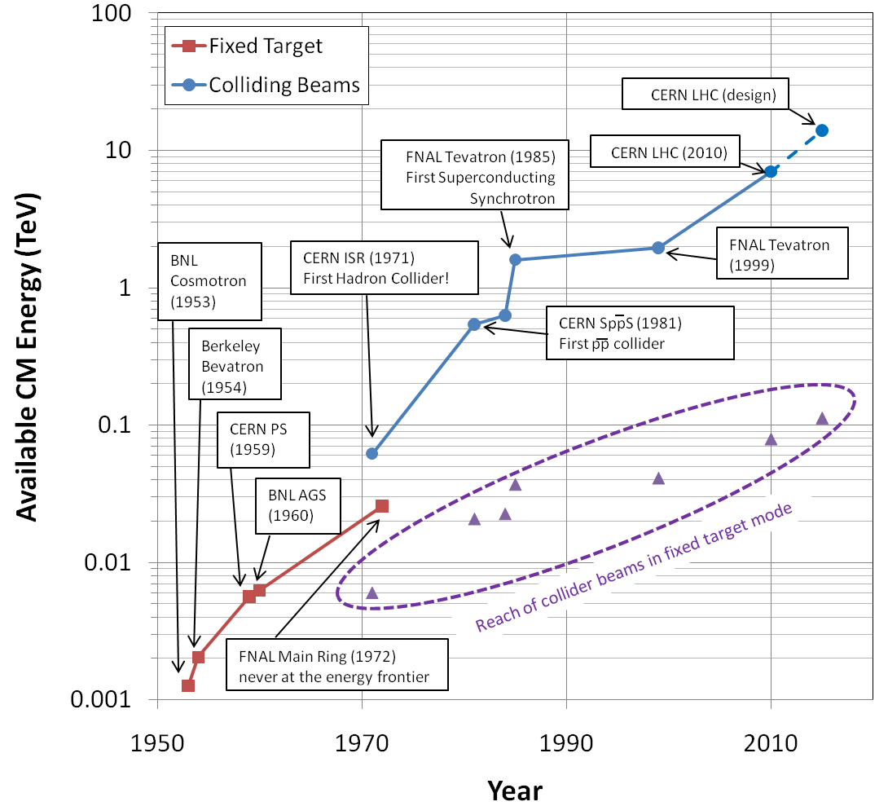
Evolution of the Accelerator Energy Frontier
~a factor of 10 every 15 years
That trend will not continue
proton mass

Slide 48
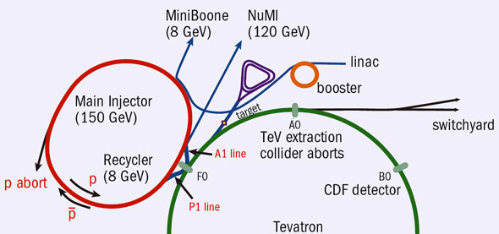
Fermilab Accelerator Complex Today
As LHC takes over the Energy Frontier, Fermilab focuses on intensity-based physics
Recycler: Formerly for pBar storage, now for proton pre-stacking
Accumulator/Debuncher: Formerly for pBar accumulation, soon muon and proton manipulation (Delivery Ring)
Neutrinos
LBNF*
(120 GeV)
/Noνa
~45 years old!
/400 MeV
/8 GeV
120 GeV+secondaries
*proposed

Slide 49
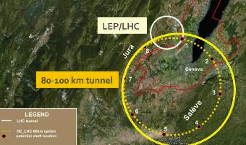
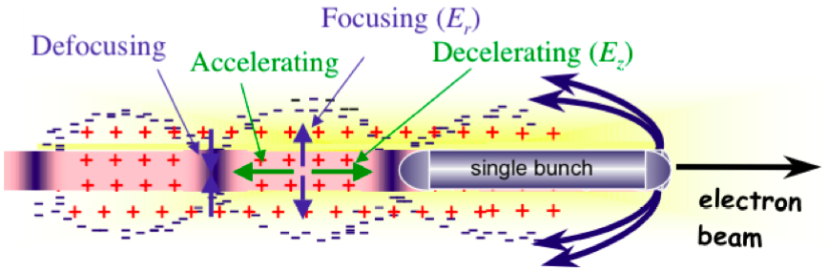
Possible Future Accelerators
Circular Hadron Colliders
“Future Circular Collider”: 100 km 50+50 TeV proton collider, based at CERN
Linear e⁺e⁻ colliders
“International Linear Collider” (ILC): Up to 500+500 GeV e⁺e⁻ collider
Not energy frontier!
“Compact Linear Collider” (CLIC): Up to 1.5 TeV+1.5 TeV e⁺e⁻ collider
Muon collider?
Muons are point-like, like electrons, but don’t radiate as much (good)
but they are unstable (bad)
R&D to find a way to cool them and collide them before they decay
Up to 5 TeV+5 TeV μ⁺μ⁻
Even more exotic?
Plasma wakefield?
Dielectric wakefield?
Huge fields, but also huge technical challenges

Slide 50
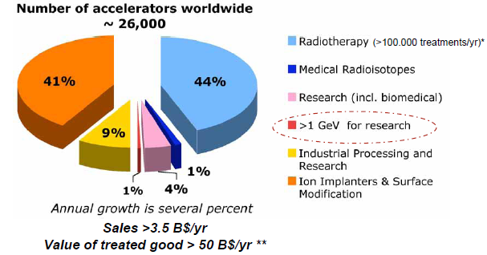
Research Machines: Just the Tip of the Iceberg

Slide 51
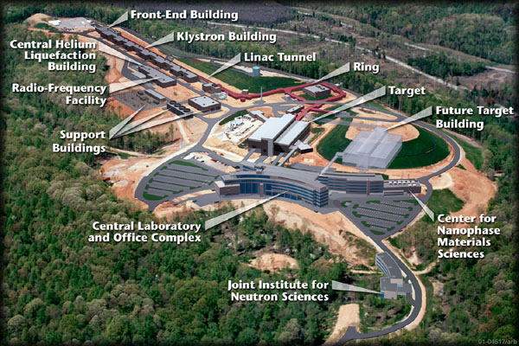
Example: Spallation Neutron Source (Oak Ridge, TN)
A 1 GeV Linac loads 1.5E14 protons into a non-accelerating synchrotron ring.
These are fast extracted onto a Mercury target
This happens at 60 Hz -> 1.4 MW
Neutrons are used for biophysics, materials science, industry, etc…

Slide 52
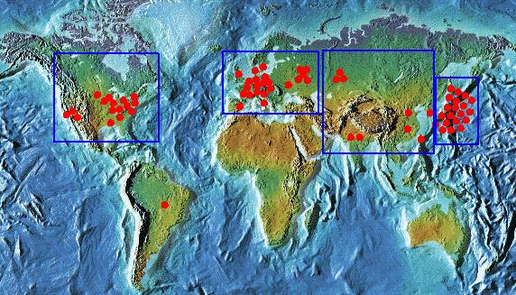
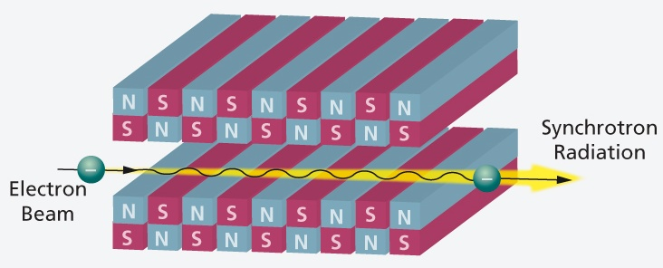
Light sources: too many to count
Put circulating electron beam through an “undulator” to create synchrotron radiation (typically X-ray)
Many applications in biophysics, materials science, industry.
New proposed machines will use very short bunches to create coherent light.

Slide 53
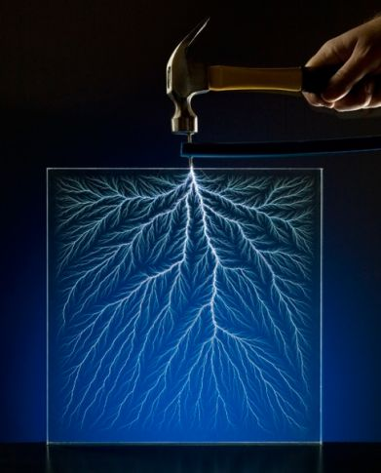
Other uses of accelerators
Radioisotope production
Medical treatment
Electron welding
Food sterilization
Catalyzed polymerization
Even art…
In a “Lichtenberg figure”, a low energy electron linac is used to implant a layer of charge in a sheet of lucite. This charge can remain for weeks until it is discharged by a mechanical disruption.

Slide 54
Further Reading (in Order of Increasing Depth)
My lectures at the 2014 Hadron Collider Physics Summer School
More details about Fermilab and the LHC (including “The Incident)
http://tinyurl.com/prebys-hcpss-2014
Fermilab “Accelerator Concepts” (“Rookie Book”)
http://www-bdnew.fnal.gov/operations/rookie_books/Concepts_v3.6.pdf
Particularly chapters II-IV
Edmund Wilson, “Particle Accelerators”
Concise reference on a number of major topics
Available in paperback (important if you are paying)
Good reference for a non-accelerator physicist
Edwards and Syphers “An Introduction to the Physics of High Energy Accelerators”
My personal favorite
Concise. Scope and level just right to get a solid grasp of the topic
Crazy expensive, for some reason.
Helmut Wiedemann, “Particle Accelerator Physics”
Probably the most complete and thorough book around (originally two volumes)
Well written
Scope and mathematical level very high
USPAS Course: http://uspas.fnal.gov/

Slide 55
Backup Slides

Slide 56
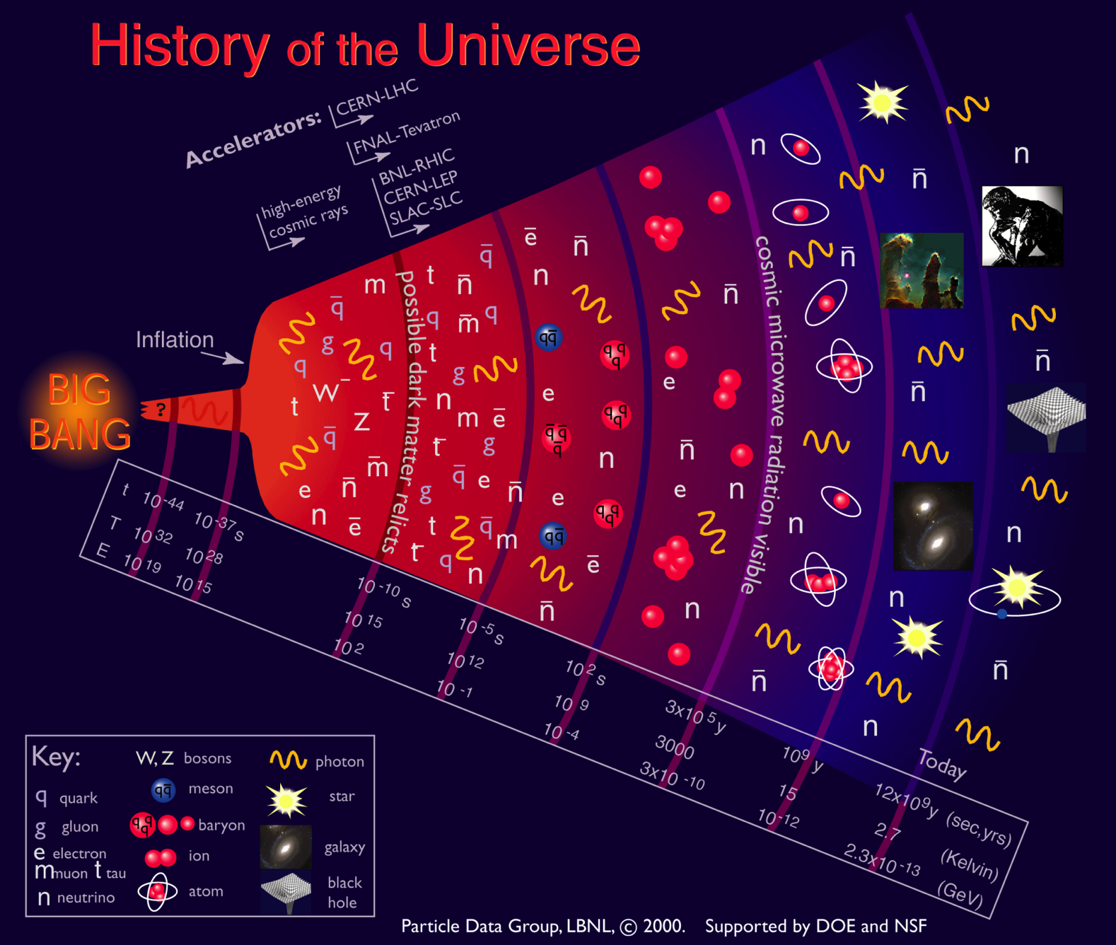
Motivation
Going to higher energies = going back in time

Slide 57
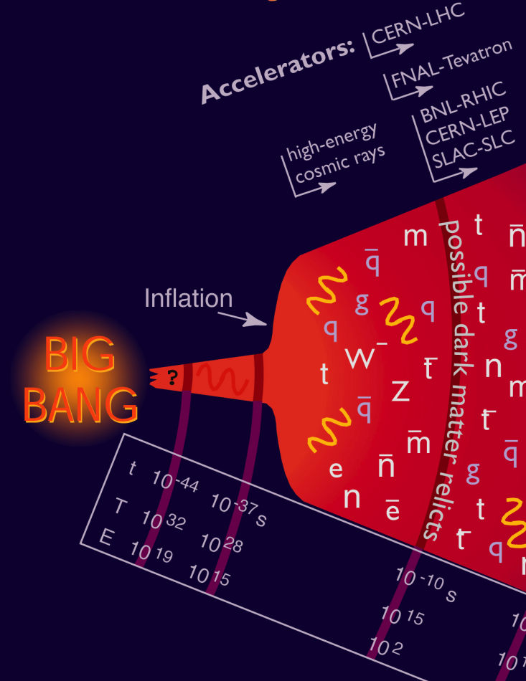
Where We Are…
Accelerators allow us to go back 13.8 billion years and recreate conditions that existed a few trillionths of a second after the Big Bang
the place where our current understanding of physics breaks down.
In addition to high energy, we need high “luminosity” that is, lots of particles interacting, to see rare processes.

Slide 58
Limits to Luminosity*
“Brightness”, limited by
Space charge blowup at low energy
Max beam-beam tune-shift
Total beam current, limited by machine protection(!), e⁻cloud and other instabilities
β*, limited by
magnet technology
chromatic effects
Geometric factor, related to crossing angle…
*see, eg, F. Zimmermann, “CERN Upgrade Plans”, EPS-HEP 09, Krakow, for a thorough discussion of luminosity factors.

Slide 59
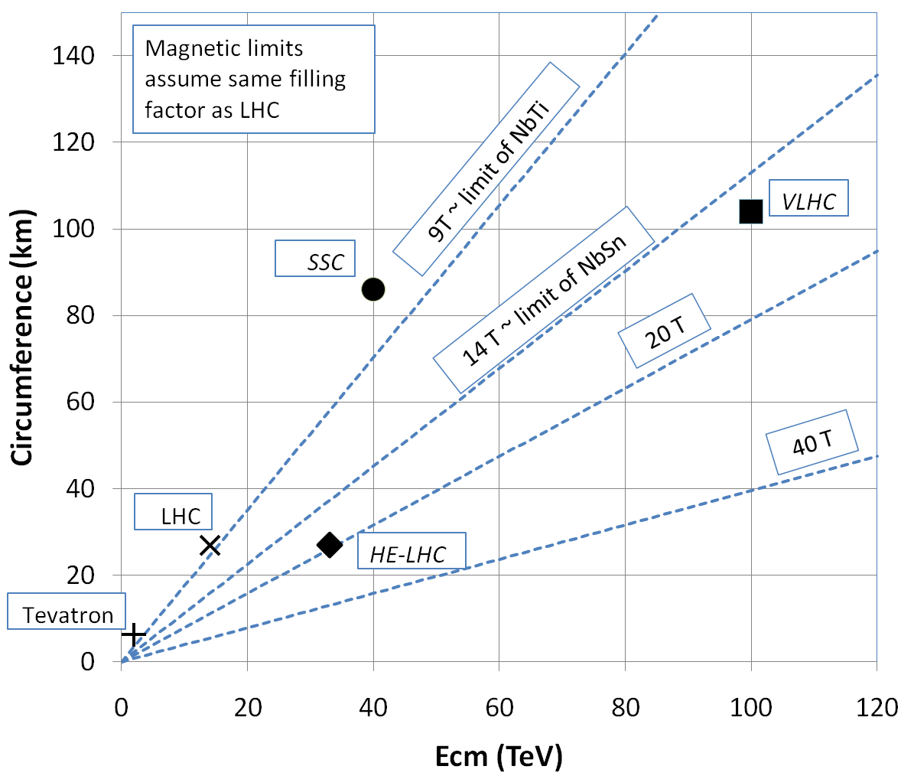
What next?
The energy of Hadron colliders is limited by feasible size and magnet technology. Options:
Get very large (~100 km circumference)
More powerful magnets (requires new technology)
All accelerator magnets based on this
Future magnets could be based on this

Slide 60
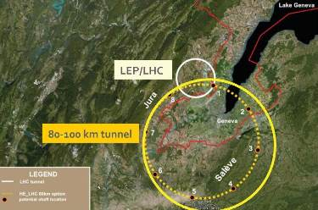
Future Circular Collider (FCC)
Currently being discussed for ~2030s
80-100 km in circumference
Niobium-3-Tin (Nb₃Sn) magnets.
~100 TeV center of mass energy

Slide 61
Other Paths to the Energy Frontier
Leptons vs. Hadrons revisited
Because 100% of the beam energy is available to the reaction, a lepton collider is competitive with a hadron collider of ~5-10 times the beam energy (depending on the physics).
A lepton collider of >1 TeV/beam could compete with the discovery potential of the LHC
A lower energy lepton collider could be very useful for precision tests, but I’m talking about direct energy frontier discoveries.
Unfortunately, building such a collider is VERY, VERY hard
Eventually, circular e⁺e⁻ colliders will radiate away all of their energy each turn
LEP reached 100 GeV/beam with a 27 km circuference synchrotron!
➔ Next e⁺e⁻ collider will be linear

Slide 62
International Linear Collider (ILC)
LEP was the limit of circular e⁺e⁻ colliders
Next step must be linear collider
Proposed ILC 30 km long, 250 x 250 GeV e⁺e⁻ (NOT energy frontier)
We don’t yet know whether that’s high enough energy to be interesting
Need to wait for LHC results
What if we need more?

Slide 63
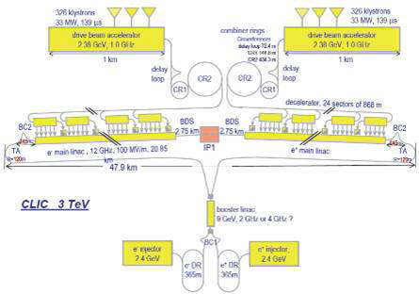
“Compact” (ha ha) Linear Collider (CLIC)?
Use low energy, high current electron beams to drive high energy accelerating structures
Up to 1.5 x 1.5 TeV, but VERY, VERY hard

Slide 64

Muon colliders?
Muons are pointlike, like electrons, but because they’re heavier, synchrotron radiation is much less of a problem.
Unfortunately, muons are unstable, so you have to produce them, cool them, and collide them, before they decay.

Slide 65
Wakefield accelerators?
Many advances have been made in exploiting the huge fields that are produced in plasma oscillations.
Potential for accelerating gradients many orders of magnitude beyond RF cavities.
Still a long way to go for a practical accelerator.

Slide 66
Units of energy: Electron Volts
An “electron-volt” is the energy gained by a particle of unit charge is accelerated over 1V potential
It is really small
1eV =1.6x10⁻¹⁹ (=.00000000000000000016) Joules - our usual unit of energy.
A 1 kg weight dropped 1m would have 6x10¹⁸ eV of energy!
On the other hand, it’s a very useful unit when talking about individual particles
If we accelerate a proton using an electrical potential, we know exactly what the energy is.
It’s also useful when thinking about mass/energy equivalence

Slide 67
Another way to look at energy…
Quantum mechanics tells us all particles have a wavelength
So going to higher energy allows us to probe smaller and smaller scales
If we put the high equivalent mass and the small scales together, we have…
“Planck Constant”
momentum
as v approaches c

Slide 68



Understanding Energy
High Energy Physics is based on Einstein’s equivalence of Mass and Energy
All reactions involve some mass changing either to or from energy
If we could convert a kilogram of mass entirely to energy, it would supply all the electricity in the United States for almost a day.
Chemical Explosion
Hydrogen Bomb
.00000005% of mass converted to energy.
~.1% (of just the Hydrogen!) converted.

Slide 69
Kinetic Energy
A body in motion will have a total energy given by
The difference between this and mc² is called the “kinetic energy”
Here are some examples of kinetic energy
For v<<c (speed of light),
Kinetic energy ~ ½mv²
Kinetic Energy
Rest Energy
Example | Velocity | Velocity/ Speed of light | Kinetic Energy/(mc²)
Race car | 150 mph | .0000002 | .000000000000025
Apollo 12 (fastest men) | 24,791 mph | .000037 | .00000000068
Proton in the LHC (full energy) | Light minus 2.7 m/s | .999999991 | 7500
Electron in LEP | Light minus 3.6 mm/s | .999999999988 | 203,000

Slide 70
Equations of Motion
If we go through the equations, keeping only terms which are linear in x and y, we get
Most generic treatment of small deviation from equilibrium in periodic system
“Hill’s Equation”, first used to study the stability of the lunar orbit
Looks “kinda sorta” like a harmonic oscillator. If K is constant, then not surprisingly, this works!
Local curvature due to dipole field (function of s)
Periodic
Independent of energy for synchrotron!
“Rigidity”
so try

Slide 71

When is a superconductor not a superconductor?
Superconductor can change phase back to normal conductor by crossing the “critical surface”
When this happens, the conductor heats quickly, causing the surrounding conductor to go normal and dumping lots of heat into the liquid Helium➔“quench”
all of the energy stored in the magnet must be dissipated in some way
Dealing with quenches is the single biggest issue for any superconducting synchrotron!
Can push the B field (current) too high
Can increase the temp, through heat leaks, deposited energy or mechanical deformation
T_{c}

Slide 72

Quench Example: MRI Magnet*
*pulled off the web. We recover our Helium.

Slide 73
Partial LHC Timeline
1994:
The CERN Council formally approves the LHC
2000:
LEP completes its final run
First dipole magnet delivered
2007
Last magnet delivered
First sector cold
All interconnections completed
2008
Accelerator complete
Last public access
Ring cold and under vacuum
September 10th: First circulating beam
September 19th: BAD accident brings beam down for almost 2 years

Slide 74



It begins…
9:35 – First beam injected
9:58 – beam past CMS to point 6 dump
10:15 – beam to point 1 (ATLAS)
10:26 – First turn!
…and there was much rejoicing
Commissioning proceeded smoothly and rapidly until September 19th, when something very bad happened

Slide 75



It Ends: “The Incident”
A quench developed into an arc
This caused Helium to boil
The resulting pressure did a great deal of damage, and kept the machine off for more than a year.
Debris in beam vacuum pipe
Clean
Insulation
Soot
Secondary arcs

Slide 76



After the Incident
The LHC was off for almost two years to repair the damage and partially address the cause.
2010: Came up at a reduced energy: 3.5 TeV + 3.5 TeV
2012: Increased energy to 4 TeV + 4 TeV
Announced the discovery of Higgs particle July 4, 2012
Responsible to giving particles mass
Last piece of the “Standard Model”
2013 Nobel prize to Higgs and Englert

Slide 77
Plans for LHC
The LHC will be the centerpiece of the world’s energy frontier physics program for at least the next 15-20fd years.
The machine is currently of to fix the issue which cause “the incident”
Accelerator will come back up in 2015 at something close to the design energy
At least 6.5 TeV/beam
Planning major upgrades to increase luminosity in ~2023

Slide 78


Some other important accelerators (past):
LEP (at CERN):
27 km in circumference - e+e- - Primarily at 2E=M_{Z} (90 GeV) - Pushed to E_{CM}=200GeV - L = 2E31 - Highest energy circular e+e- collider that will ever be built. - Tunnel now houses LHC
SLC (at SLAC):
2 km long LINAC accelerated electrons AND positrons on opposite phases. - 2E=M_{Z} (90 GeV) - polarized - L = 3E30 - Proof of principle for linear collider

Slide 79


B-Factories
- B-Factories collide e+e- at E_{CM} = M(ϒ(4S)). -Asymmetric beam energy (moving center of mass) allows for time-dependent measurement of B-decays to study CP violation.
KEKB (Belle Experiment):
- Located at KEK (Japan) - 8GeV e- x 3.5 GeV e+ - Peak luminosity >1e34
PEP-II (BaBar Experiment)
- Located at SLAC (USA) - 9GeV e- x 3.1 GeV e+ - Peak luminosity >1e34

Slide 80

Relativistic Heavy Ion Collider (RHIC)
- Located at Brookhaven:
Can collide protons (at 28.1 GeV) and many types of ions up to Gold (at 11 GeV/amu).
Luminosity: 2E26 for Gold
Goal: heavy ion physics, quark-gluon plasma, ??

Slide 81

Continuous Electron Beam Accelerator Facility (CEBAF)
Locate at Jefferson Laboratory, Newport News, VA
6GeV e- at 200 uA continuous current
Nuclear physics, precision spectroscopy, etc

